Slide 1
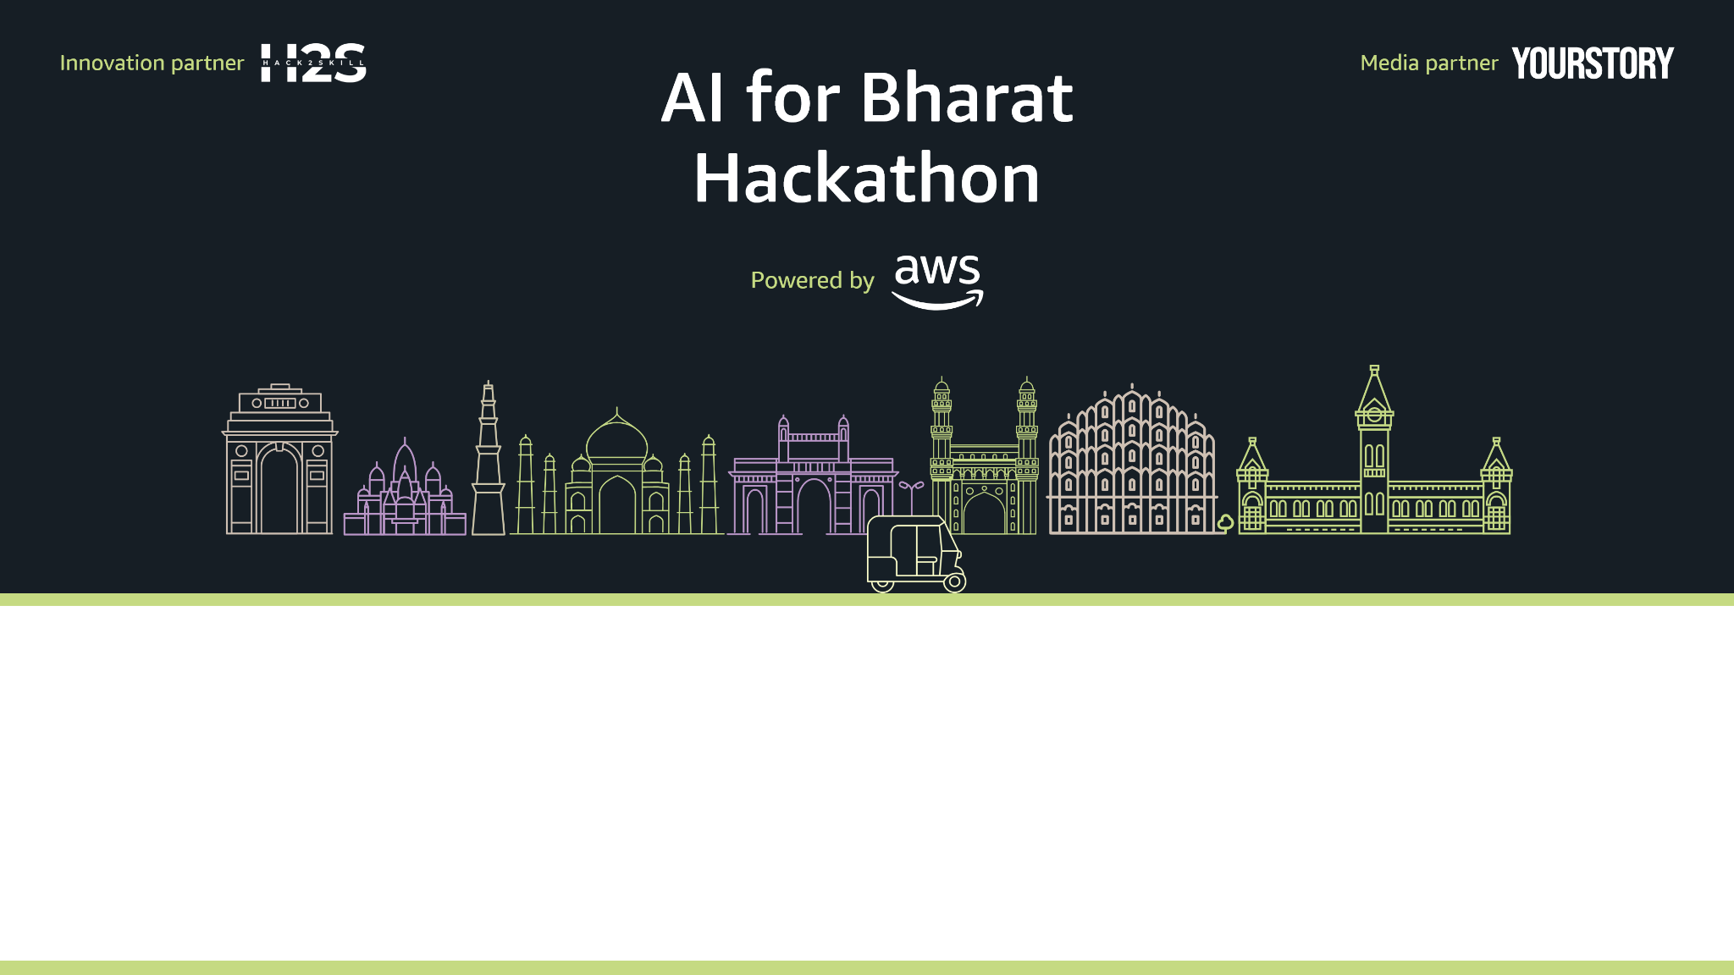
Team Name : Ether
Team Leader Name : Vansh Vashishtha
Problem Statement : Build an AI powered solution that supports rural ecosystems, sustainability or resource – efficient systems.

Slide 2
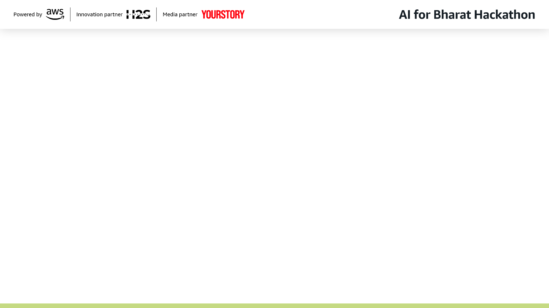
Brief about the Idea:
The Problem: ₹1.5 Lakh Crore Annual Loss
Indian farmers lose ₹1.5 lakh crore worth of produce annually due to post-harvest inefficiencies and lack of market access.
Key Statistics:
86% of farmers 120 million are small/marginal holders with zero bargaining power
Farmers lose 4060% of value to intermediaries
Post-harvest losses: 48% cereals, 515% fruits & vegetables
60% farmers have no formal credit access → forced to sell immediately at low prices
The Real Problem: When a farmer harvests, the local trader is often the only buyer accessible within 24 hours.Trader offers ₹12/kg while fair price is ₹16/kg. But farmer needs immediate cash and has noalternatives.
What Farmers Actually Need:
Not more price information apps. They need multiple competing buyers + instant payment.
The Solution: FarmFast
AI-powered instant marketplace that connects farmers with multiple buyers within 1 hour viaWhatsApp.
Core Value: Farmer lists produce → Gets 3+ competitive offers → Selects best → Gets paid
same day

Slide 3
How different is it from any of the other existing ideas?
Existing Solutions:
NaPanta, AgroStar → Provide price info but no buyer connections
E-mandis → Require physical transport with upfront costs
Advisory apps → Give information but don't create market access
FarmFast is Different:
Instant buyer matching - 1020 buyers compete for your produce
AI quality grading - Objective A/B/C grade builds trust
WhatsApp-first - No app download, works on feature phones
Payment escrow - Guaranteed same-day payment
Free for farmers - Buyers pay 2% commission
How will it be able to solve the problem?
For Framers:
Competitive bidding eliminates single-buyer exploitation
Quality grading helps negotiate fair prices
Instant payment eliminates distress selling
Voice interface works for illiterate users
For Buyers:
Quality-graded produce reduces wastage risk
Direct sourcing saves 20-30% vs mandi
Faster procurement (no travel to mandis)
Impact:
15-20% farmer income increase
5% post-harvest loss reduction = ₹7,500 crore saved
Reaches 120 million small/marginal farmers
USP of the proposed solution: Only platform combining AI quality grading + instant buyer matching + same-day payment escrow in a WhatsApp-first interface for illiterate farmers.

Slide 4
List of features offered by solution
1. Voice-First WhatsApp Interface
List produce via voice note in Hindi/Marathi/Telugu/Tamil/Kannada
No typing or reading required
Works on feature phones with 2G connectivity
2. AI Quality Grading
Photo → A/B/C grade based on color, defects, uniformity
Farmer understands produce value objectively
Reduces buyer-seller disputes
3. Instant Buyer Broadcast 5-minute reach
Listing sent to 1020 nearby buyers (traders, FPOs, restaurants)
Geospatial matching within 20km radius
Push notifications to buyer apps
4. Competitive Bidding
Multiple buyers submit offers
Farmer sees all offers ranked by price
Voice comparison: "First offer ₹16/kg is 25% above local rate"
5. Secure Escrow Payment
Buyer pays via UPI before pickup
Platform holds payment until handover confirmed
Released to farmer within 30 seconds
Zero payment defaults
6. Quality-Based Pricing Intelligence
Shows fair price range based on grade
"Your B-grade tomatoes worth ₹14.16/kg today"
Updated daily from mandi data + platform transactions
7. Buyer Dashboard
Browse active listings with quality grades
Filter by crop, grade, distance, quantity
Submit offers, track pickups
8. Transaction History
Track all sales: date, buyer, price, quantity
Compare earnings vs local trader rates
Learn seasonal patterns and reliable buyers

Slide 5
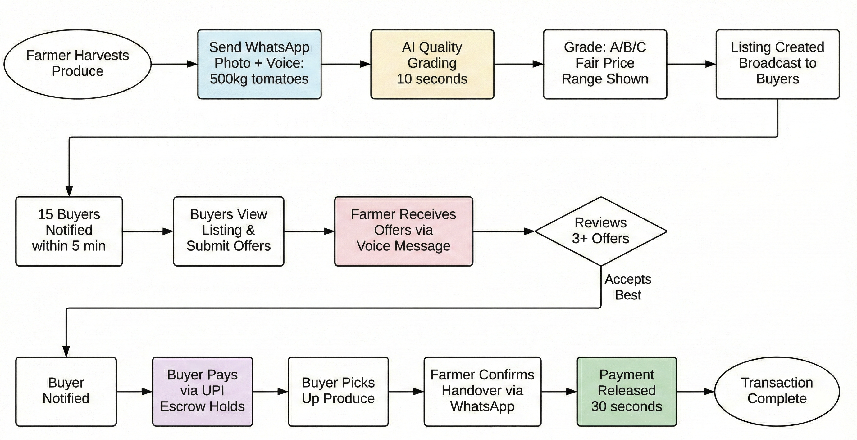
Process flow diagram
. Key Metrics
First Offer – 30 minutes
Minimum Offers – 2 to 3 within an hour
Payment Speed – 30s after handover
Payment Success Rate - 100% (escrow-guarantee)

Slide 6
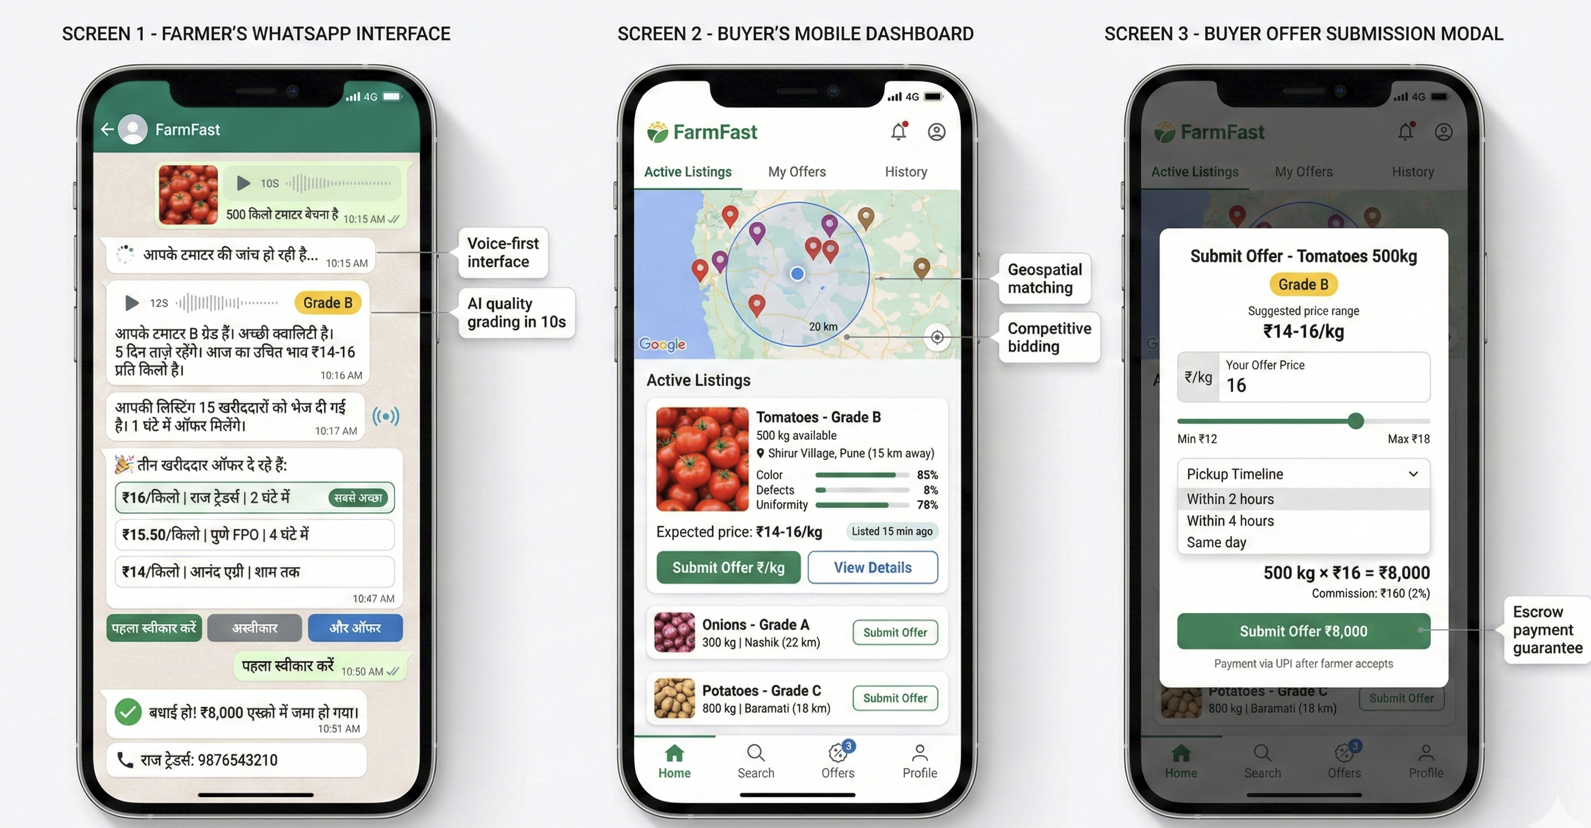
Mock UI of the proposed solution
Design Principles
Voice-first
Button Based Actions
Regional Languages
Works on 2G Networks

Slide 7
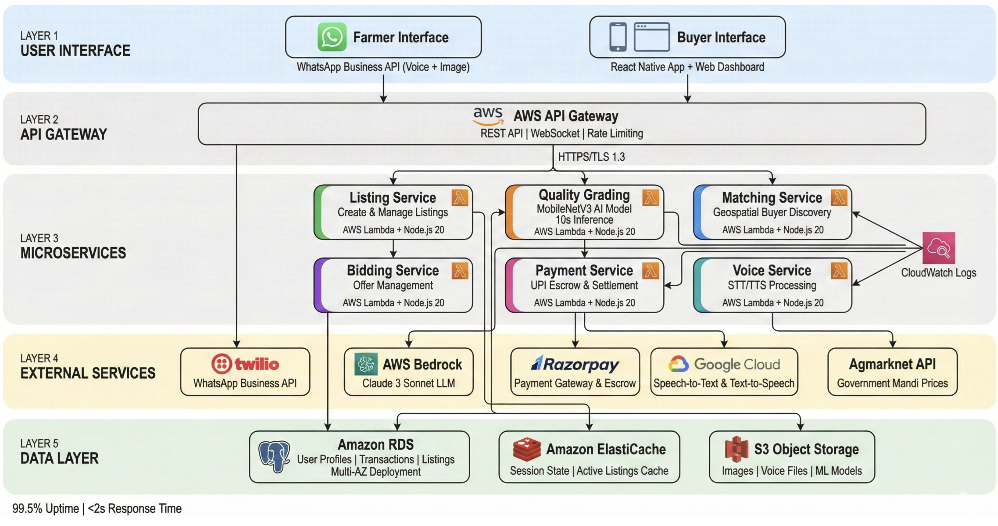
Architecture diagram of the proposed solution:

Slide 8
Technologies to be used in the solution:
Layer | Technology | Purpose
Frontend | React Native | Buyer mobile app (Android)
 | React 18 + TypeScript | Buyer web dashboard
Backend | AWS Lambda (Node.js 20) | Serverless microservices
 | AWS API Gateway | API routing, rate limiting
 | PostgreSQL 15 (RDS) | Transaction data, user profiles
 | Redis (ElastiCache) | Session cache, active listings
 | AWS S3 | Image storage, ML models
AI/ML | MobileNetV3 (TensorFlow) | Quality grading model
 | AWS Bedrock Claude | LLM advisory generation
 | Google Cloud Speech | STT/TTS (5 languages)
Communication | Twilio WhatsApp Business API | Farmer interface
Payments | Razorpay | UPI escrow, settlements
Monitoring | AWS CloudWatch | Logs, metrics, alerts
DevOps | GitHub Actions | CI/CD pipeline

Slide 9
Estimated implementation cost :
Category | Monthly | Annual
AWS Infrastructure
Lambda + API Gateway | ₹5,000 | ₹60,000
RDS PostgreSQL | ₹8,000 | ₹96,000
S3 + ElastiCache + CloudFront | ₹7,000 | ₹84,000
External Services
Twilio WhatsApp | ₹20,000 | ₹2,40,000
AWS Bedrock (LLM) | ₹8,000 | ₹96,000
Google Speech API | ₹5,000 | ₹60,000
Razorpay | ₹3,000 | ₹36,000
Team
2 Engineers + 1 Operations | ₹1,30,000 | ₹15,60,000
Total | ₹1,86,000 | ₹22,32,000

Slide 10
Overall Impact
Social Impact
Farmer Income:
15-20% income increase per transaction
Additional ₹8,000-12,000 annual income per farmer
120 million farmers = ₹12 lakh crore wealth transfer over 5 years
Food Security:
5% post-harvest loss reduction = ₹7,500 crore saved annually
12 million tons more food reaches consumers
Feeds 25 million additional people
Financial Inclusion:
Reduces dependence on 30-40% interest informal loans
Saves ₹3,000-5,000 per farmer annually in interest
Environmental:
Reduced food waste = Lower carbon footprint
Optimized transport logistics
Incentivizes quality over quantity

Slide 11
